Slide 1



José Miguel González

Slide 2
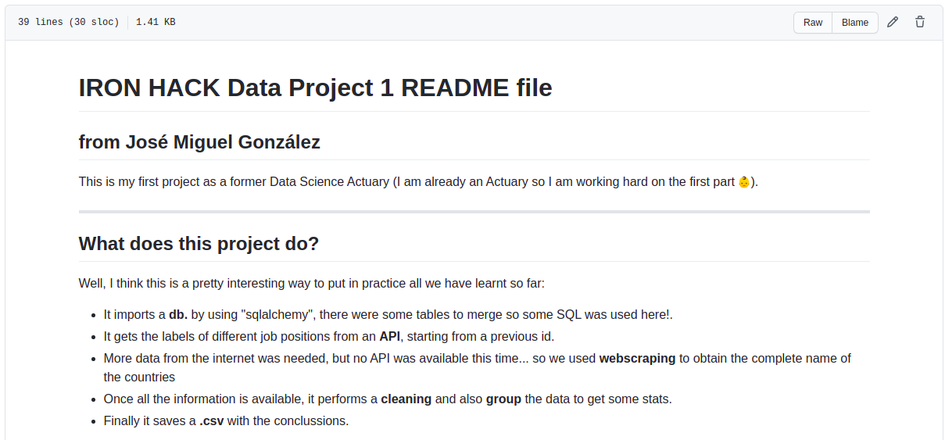

Slide 3
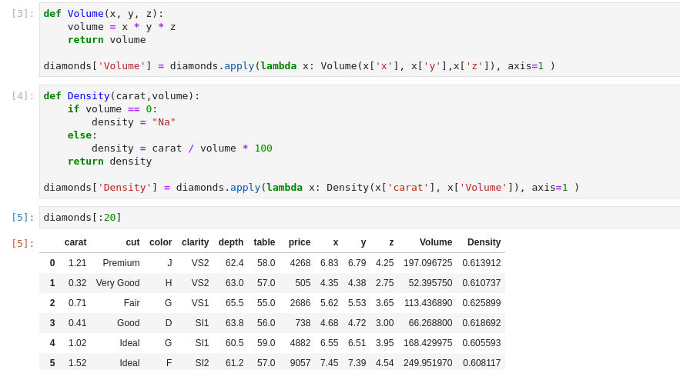
Some data wrangling trials:
To be honest
not very representative...

Slide 4
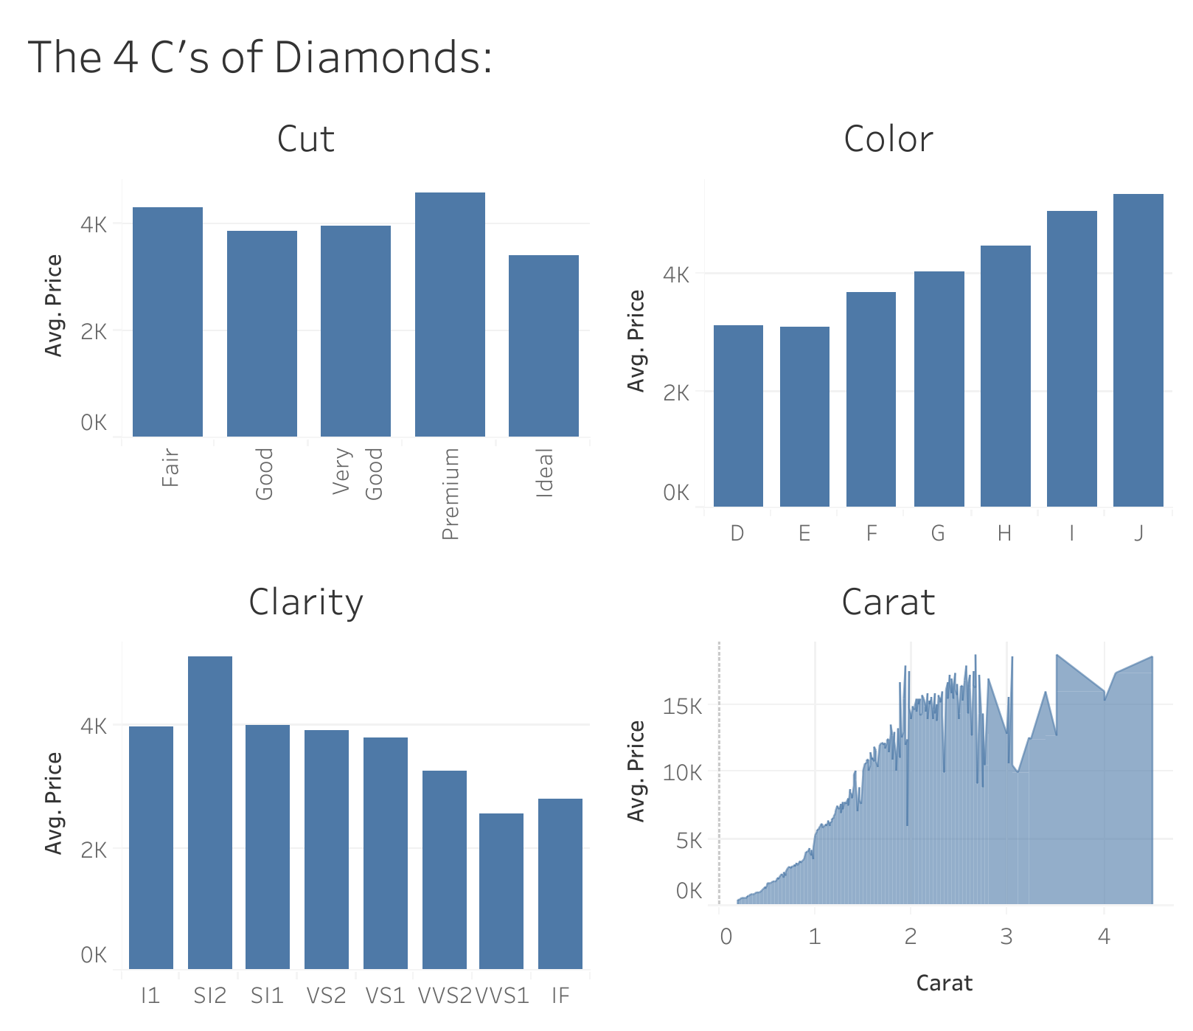
Not the most elegant, but maybe the most villain...

